Slide 1


UNIT 7: THE WORLD OF WORK
LESSON 1 : A1

Slide 2

Answer the questions
1. What time do you often have your breakfast ?
2. What time do your classes start ?
3. What time do your classes finish ?

Slide 3

with their definitions
1. during (prep): throughout the course or duration of (a period of time)
2. (to) work hard: always doing a lot of work
3. (to) last: continue for a specified period of time
4. almost (adv): Near to in quantity or amount
5. school year (n) the months of the year during which school is open and attendance at school is required

Slide 4
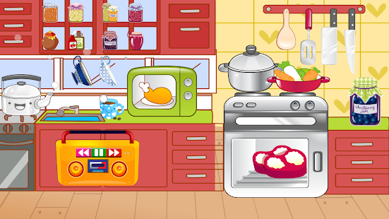
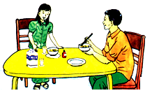
WHAT ARE THEY TALKING ABOUT ?

Slide 5

Uncle: Eat your breakfast, Hoa. It’s half past six. You’ll be late for school
Hoa: I won’t be late, uncle. I’m usually early. Our classes start at 7.00
Uncle: And what time do your classes finish?
Hoa: At a quarter past eleven. Then in the afternoon I do my homework. That takes about two hours each day.
Uncle: You work quite hard, Hoa. When will you have a vacation?
Hoa: Our summer vacation starts in June. It lasts for almost three months.
Uncle: What will you do during the vacation?
Hoa: I’ll go and see my Mom and Dad on their farm. I always like helping them. They work very hard, but we have fun working together.

Slide 6
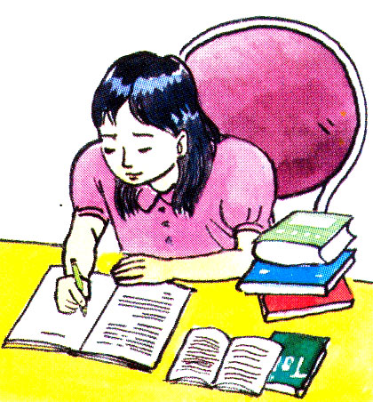
Fill in the blanks about Hoa
hours
classes
June
is
finishes
finish
class
lasts
will not
are
1. Hoa_____________a student
2. She _____________ be late for school
3. Hoa’s summer vacation starts in _____________
4. Her _____________ start at 7.00
5. They _____________ at 11.15
6. In the afternoon she does her homework about two _____________ each day .
7. Her summer vacation _____________ for almost
three months

Slide 7
Answer the questions
A. What time do Hoa’s classes start ?
B. What time do they finish ?
C. For how many hours a day does Hoa do her homework ?
D. What will Hoa do during her vacation ?
E. When does your school year start ?
F. When does your school year finish ?

Slide 8

Team A
Team B
1
2
3
4
10
20
30
40
50
10
20
30
40
50
5
6
7
8
page 16

Slide 9
What time do Hoa’s classes start ?
They start at 7 o'clock.

Slide 10
What will Hoa do during her vacation?
She’ll go and see Mom and Dad on their farm.
or: She’ll go and see her parents on their farm.

Slide 11



Slide 12
When does your school year start ?
It starts in August

Slide 13
For how many hours a day does Hoa
do her homework?
That takes two hours each day.

Slide 14
What time do Hoa’s classes finish?
They finish at
a quarter past eleven

Slide 16
When does your school year finish ?
It finishes in May.

Slide 17
Language notes
It takes Hoa two hours each day to do her homework.
+ Form:
It takes + someone + time + to do s.thing
Lan / Hoa / me / him / her / them / us

Slide 18
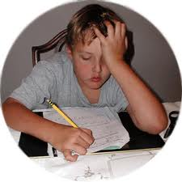
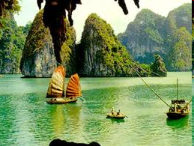
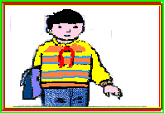
He/ 1 hour/ do the homework
It takes him one hour to do the homework
2. We / 2 days / visit Ha Long Bay
It takes us two days to visit Ha Long Bay
3. I / 10 minutes/ walk to school
It takes me 15 minutes to walk to school

Slide 19


Learn by heart the new words.
Prepare: Unit 7 lesson 2 : A 2, 3

